Slide 1
2020 KU
Introduction to Neural Networks
Predict player`s winning
using basic information on Game Dota2
- Based on OpenDota data -
2020020562 HanKyeol Kyung

Slide 2
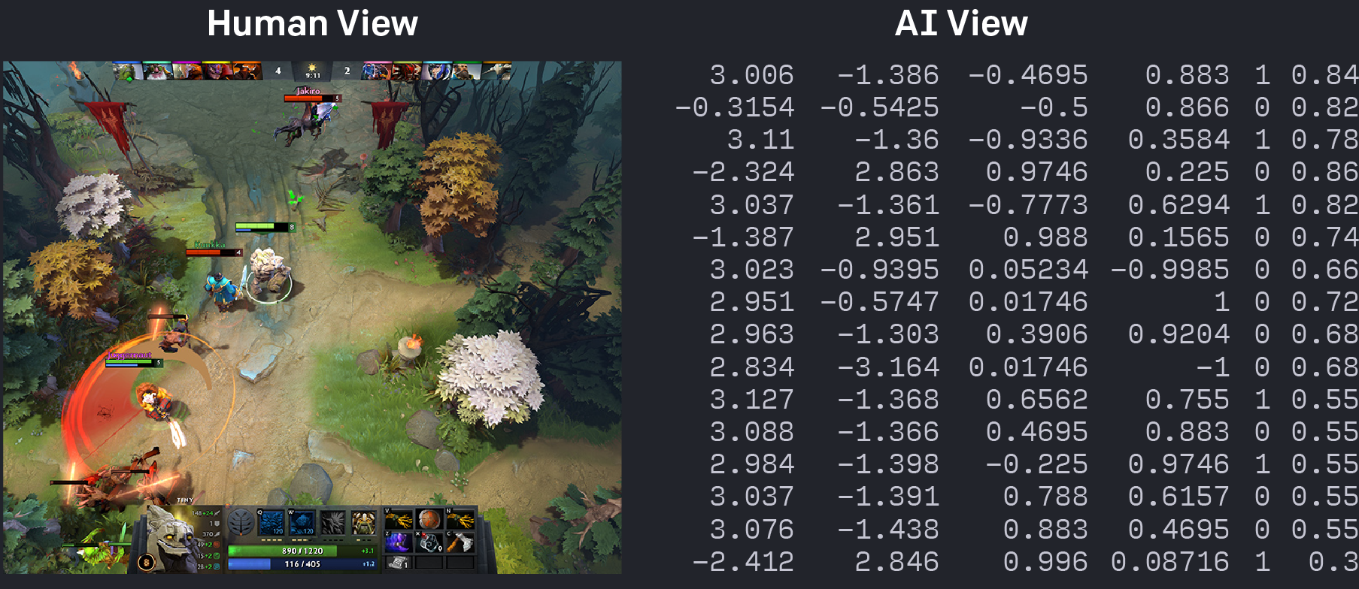


Introduction
Lots of APIs (e.g. OpenAI Five)
Game Dota2
I wanted to do project related to Dota2 which has lots of APIs for data, and one of my favorite game
My Playtime

Slide 3
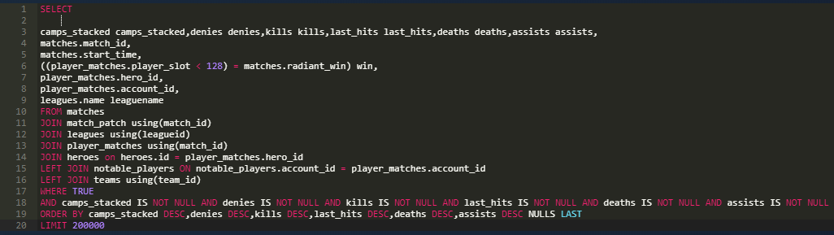
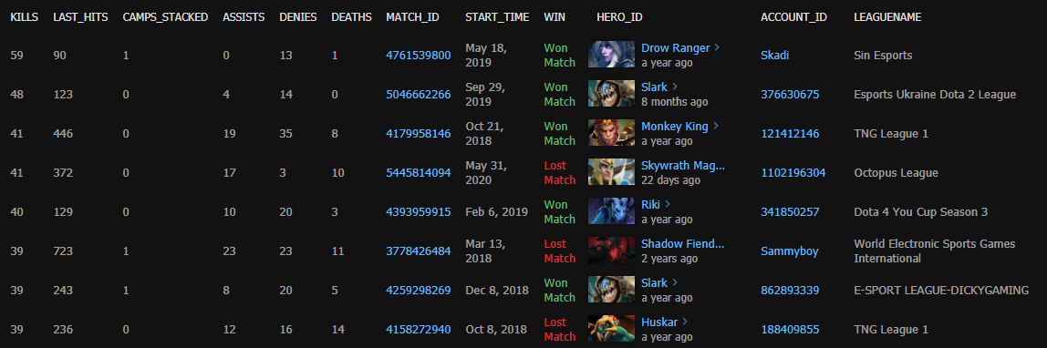
Dataset
OpenDota
Lots of Dota2 game data is available on website ‘OpenDota’.
I can use SQL to query the data I want, while some data appears or disappears by game updates.
So, I chose data not related to game changes by update.
I can export queried data to csv file to use on jupyter notebook.
.csv

Slide 4
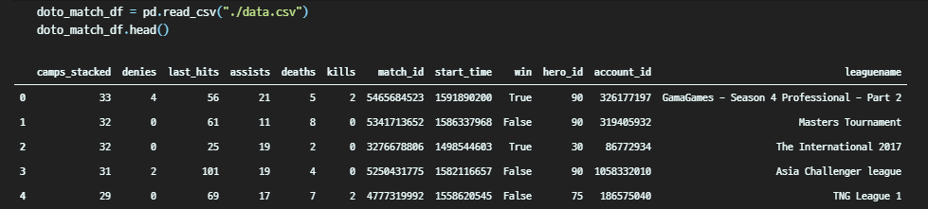
Dataset
Dataset
Using the dataset, I wanted to predict player`s win using players ‘basic’ game score (e.g. K/D/A).
: Kills, Deaths, Assists, Last Hits(CS), Denies(opposite to Last Hits), Camps Stacked(for supporter), Hero_ID
These basic game score were presented since game launching, and still not deprecated
Account ID and league name may confuse model, so neglected.
I used 200,000 data, which is abundant number to prevent overfitting on binary classification.
Applying k-Fold on lots of data is bad idea.
Match ID is used to split train and test dataset, since it is independent to game result

Slide 5
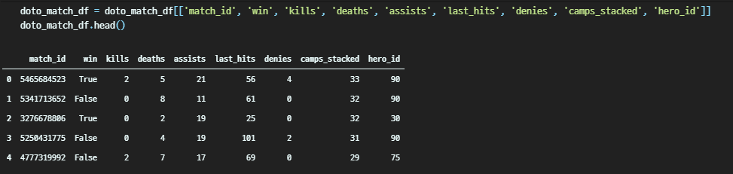
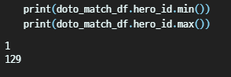
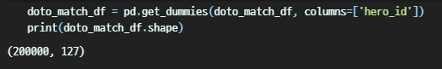
Method
One-Hot Encoding
Before use the data to predict winning, I have to preprocess each column
As each column has value in some scale, I thought normalization is not to be demanded.
But Hero ID which is long type data was problem. As it is not numerical value, but categorical, it should be encoded if not It harms training.
After checking range of Hero ID, I used one hot encoding on Hero ID column.
Column length increase quites a lot after encoding. (% Hero ID is not continuous)

Slide 6
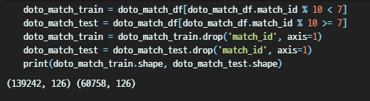
Method
Data split using hash-like data
As I mentioned before, Match ID is not relevant to game result, So I decided to use it as a standard to split
Match ID is used like SHA hashing when split data, checking end value is bigger/smaller than standard
After then, Match ID is dropped since It will not be used for model.

Slide 7
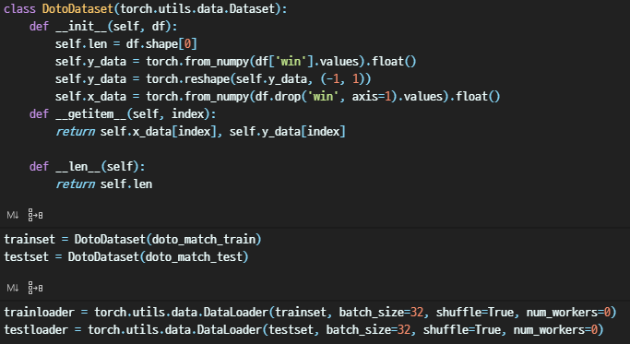
Method
Dataset & Dataloader
I made custom dataset class to load my data on dataloader.
Float data type is used for efficiency.
Mini-batch size is 32, and I`ll shuffle my data.

Slide 8
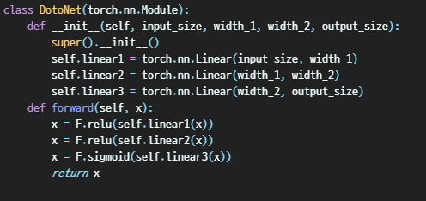
Method
Model
Being a binary classification problem, deep network is unnecessary, shallow network is used.
ReLu which is powerful and fast activation function is used for fast convergence and robustness.
This is binary classification, so sigmoid is used for activation function of last layer. (Actually, sigmoid and softmax is same on binary classification problem)

Slide 9
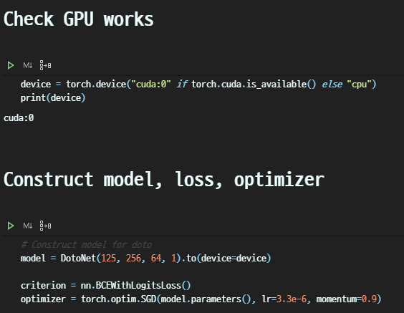
Method
Model
For computational performance, I used GPU
Considering relationship between input and size of one hot encoding vector, layer width was chosen.
BCE(Binary Classification Entropy Loss) is used for loss function
I used SGD to boost convergence speed using momentum, while using very small learning rate(3.3e-6) to find minima.

Slide 10
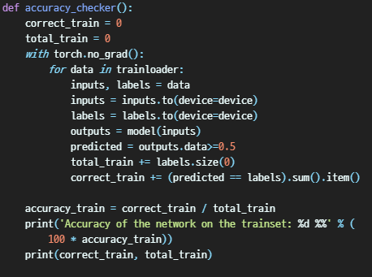
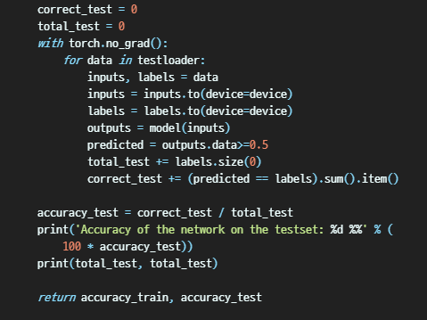
Method
Accuracy
Also I made custom accuracy function for binary classification
Every 10 epoch, I`ll check accuracy and save it to plot the result and analyze it.

Slide 11
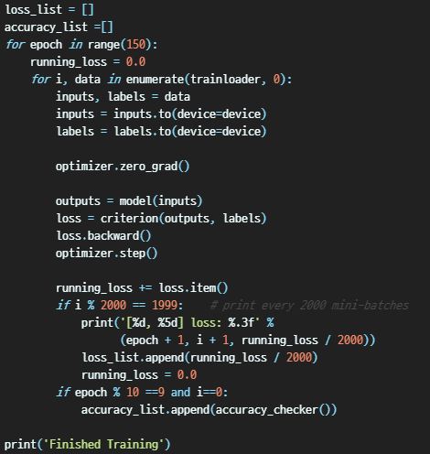
Method
Training
As learning rate is very low, I trained 150 epoch for whole batch.
Each mini batch, which is size of 32 will be adapted to GPU for fast computation and trained.
Check the loss every 2000 mini batch, and check accuracy(slightly bigger computational load) every 10 epoch.

Slide 12
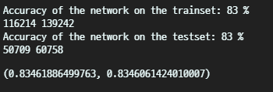
Result
Accuracy
After training, model shows accuracy of 83% for both train and test dataset. It was best fit among various hyperparameter.
I`ll explain how data shows (almost) same accuracy on both datasets.

Slide 13
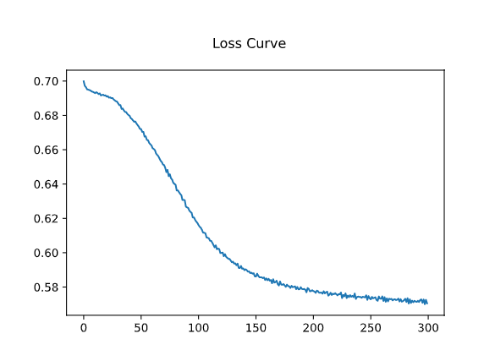
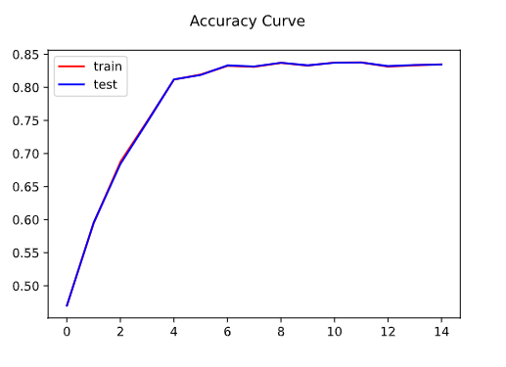
Result
Learning & Accuracy curve
I trained model until it converges. Model converges around 140 epoch.
Accuracy curves for both datasets are almost same.
Clean and many dataset on binary classification enables me prevent the overfitting not using regularization tricks like dropout or L2 regularization.

Slide 14
Discussion
Discussion
As Dota 2 is 5 vs 5 game, not 1 on 1 game, predicting the game result with only one`s score is quite hard work. But I think I`ve got good result (83% accuracy) on given situation.
Lots of clean dataset enables me make a good result
Without regularization tricks, accuracy curve for train and test dataset is almost same. This means I could prevent overfitting using ‘big dataset’
Lots of columns due to one hot encoding and layer width can cause ‘curse of dimensionality’. But lots of sample data can overcome the curse of dimensionality.

